Slide 1
COMP3017 Service Computing

Slide 2
Tools we will use in this subject
Communication
WeChat group
Lecture materials and assignment submission
Blackboard - https://bb.hitsz.edu.cn/

Slide 3
Service computing
Main concepts and importance

Slide 4
Let’s start with a quick review

Slide 5
Service
Services represent a type of relationships-based interactions (activities) between at least one service provider and one service consumer to achieve a certain business goal or solution objective.

Slide 6
Driver App
Map functions
Module 1
Module 2
Module 3
Module 4
Module 5
Module 6
Module 7
…
Warehouse App
Map functions
Module 1
Module 2
Module 3
Module 4
Module 5
Module 6
Module 7
…
Sales App
Map functions
Module 1
Module 2
Module 3
Module 4
Module 5
Module 6
Module 7
…

Slide 7
Driver App
Service consumer
Module 1
Map functions
Module 2
Module 3
Module 4
Module 5
Module 6
Module 7
…
Warehouse App
Map Service Provider
Service consumer
Module 1
Map functions
Module 2
Interface
Map functions
Module 3
Module 4
Module 5
Module 6
Module 7
…
Sales App
Communication language
Service consumer
Module 1
Map functions
Module 2
Module 3
Module 4
Module 5
Module 6
Module 7
…

Slide 8
Service Provider
Service consumer
Communication language
Interface
Functions

Slide 9
Service (definition 2)
A service is a self-contained unit of software functionality, or set of functionalities, designed to complete a specific task such as retrieving specified information or executing an operation.
Service Provider
Service consumer
Communication language
Interface
Functions

Slide 10
Service (definition 2-cont.)
It contains the code and data integrations necessary to carry out a complete, discrete business function and can be accessed remotely and interacted with or updated independently
Service Provider
Service consumer
Communication language
Interface
Functions

Slide 11
Service oriented architecture
Service-oriented architecture (SOA) is a type of software design that makes software components reusable using service interfaces that use a common communication language over a network.
SOA integrates software components that have been separately deployed and maintained and allows them to communicate and work together to form software applications across different systems.

Slide 12
How you can build applications with service orientation
You can develop your own services and use them as part of your applications
You do not need develop your own services – you can use existing services, developed and maintained by other organizations
…
You can make a service a part of your application
You can build your application by composing several existing services
…

Slide 13
What is Service Computing?
Services Computing is a cross-discipline that covers the science and technology of bridging the gap between business services and IT services.
Supports integrating the business as linked, repeatable business tasks, or services.

Slide 14
Service computing importance
Why it all started – a bit of history, background of service orientation
Importance to the community now – current benefits of service orientation
Importance to you – why should you learn about it

Slide 15
A bit of history
Background of service orientation

Slide 16
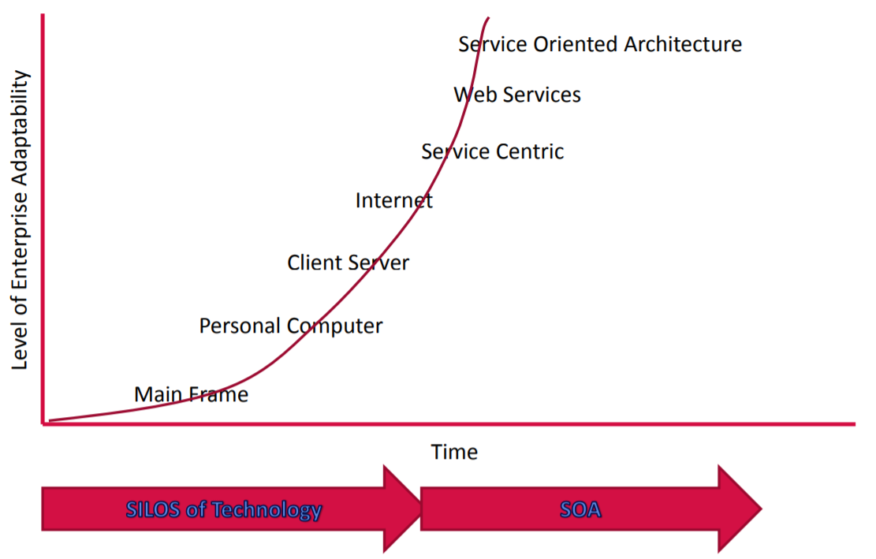
Towards Service Computing in an Enterprise

Slide 17
Towards Service Computing in an Enterprise

Slide 18
How programs were written in 60s?

Slide 19
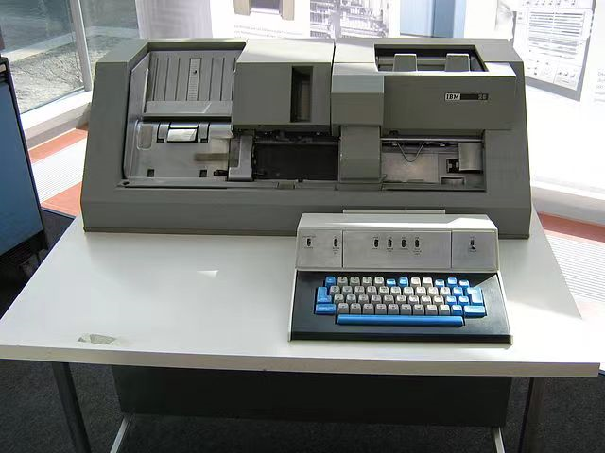
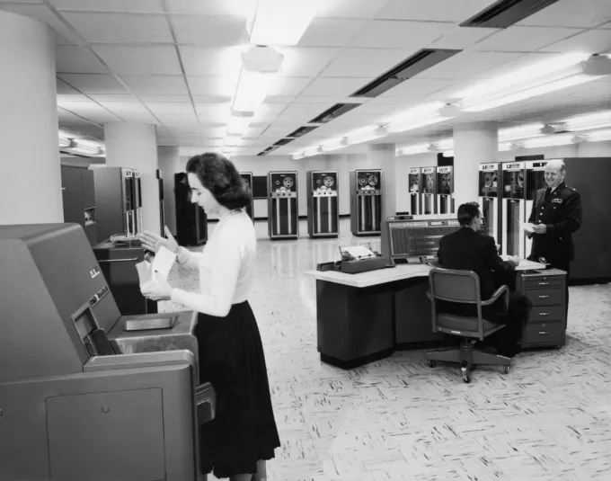
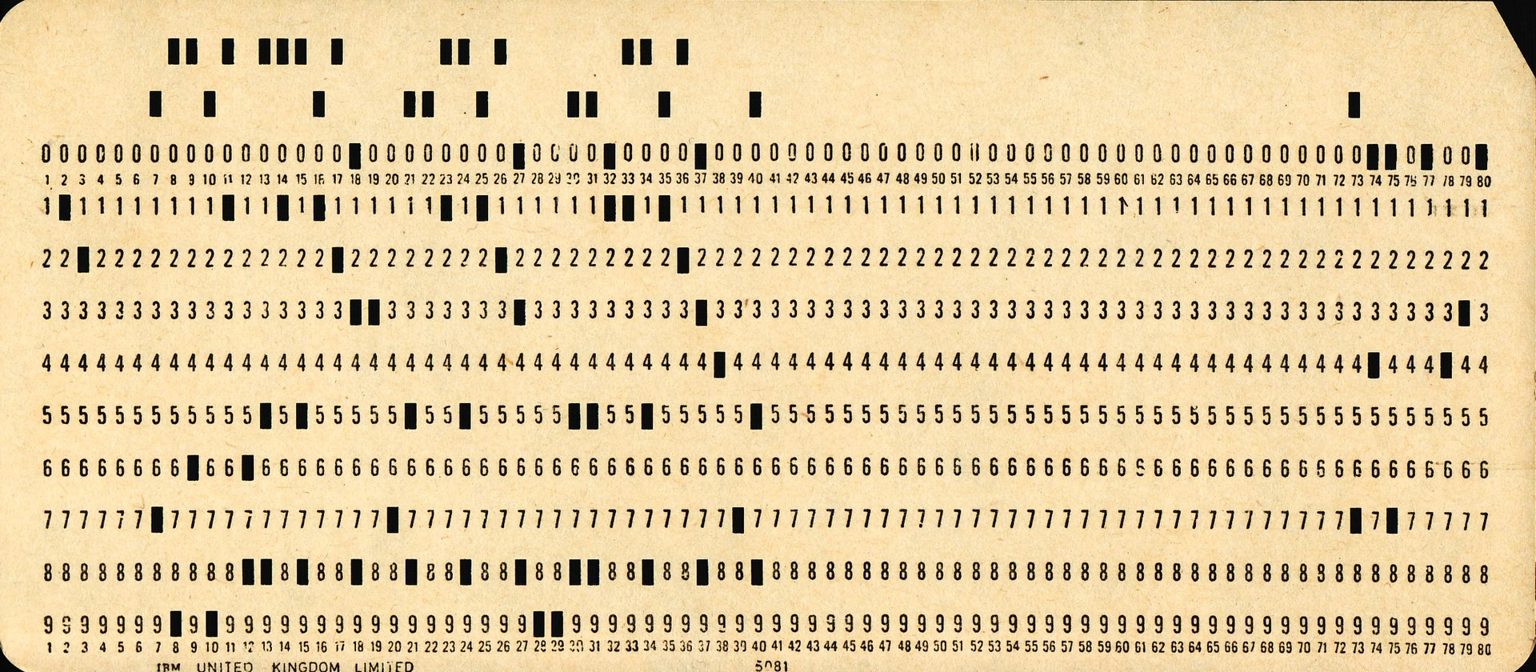
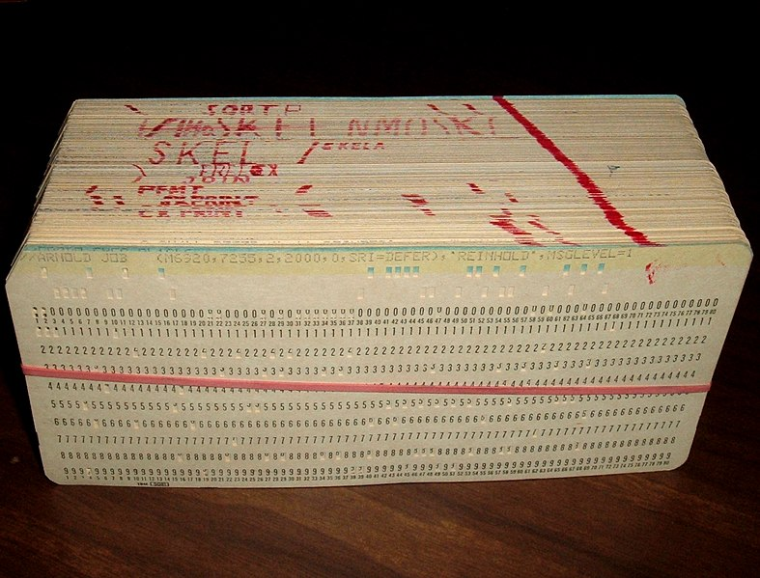
Main Frame

Slide 20
Main Frame - disadvantages
Computer
Large
Too expensive too be owned by a single person
Operated by a highly skilled personnel

Slide 21
Towards Service Computing in an Enterprise

Slide 22
Personal Computer
Relatively small
Can be afforded by individuals
No high level skills needed to operate it

Slide 23
End of a review

Slide 24
What are the problems with PC?
PC
code
database

Slide 25
What if you need to make some changes to the database on multiple PCs?

Slide 26
What if you need to make some changes to the database? – maintenance problem

Slide 27
What if your program cannot run on limited hardware?

Slide 28
What if your program cannot run on limited hardware? – performance problem

Slide 29
Personal Computer
Relatively small
Can be afforded by individuals
No high level skills needed to operate it
Program code is deployed, executed and maintained on the same machine – many challenges - maintenance, performance, …

Slide 30
Towards Service Computing in an Enterprise

Slide 31
What if you need to make some changes to the database? – maintenance problem

Slide 32
Solution – client-server model
Client
Client
Server
Client
Data
base
Client
Client
Client
Client
Client

Slide 33
Client server
A distributed application structure that partitions tasks or workloads between providers of the resource and requestors
Program is split into two parts
Server – a provider of some function
Client – requestor of the function
Client and server can be deployed on different machines
Many clients can connect to one server

Slide 34
Client server
A distributed application structure that partitions tasks or workloads between providers of the resource and requestors
Program is split into two parts
Server – a provider of some function
Client – requestor of the function
Client and server can be deployed on different machines
Many clients can connect to one server

Slide 35
Towards Service Computing in an Enterprise
Internet enabled server and client part of the program deployed on machines distributed across different networks
More exciting applications became possible, not only in the enterprise domain

Slide 36
Towards Service Computing in an Enterprise
But at the same time, the Internet exposed the limitations of client-server model in large scale dynamic environments, such as
Scalability issues
Mobility issues
…

Slide 37
Client-server vs service orientation
The traditional client-server model often lacks well-defined public contracts that are independent of the client or server implementation
this means a client is tied to a particular server
In Service Computing
components publish and use services in a peer-to-peer manner
a client is not tied to a particular server
service providers are interchangeable

Slide 38
Client-server vs service orientation
Traditional client-server – more coupled
The server exists for a specific client, without planning for re-use
In service orientation – decoupling
the server side is very independent of the client
Many different client types use the same server
In this way SOA services are designed for reuse
Coupling = 耦合性

Slide 39
Towards Service Computing in an Enterprise

Slide 40
Object orientation vs service orientation
Object oriented programming is built on the premise that programming problems can be modelled in terms of the objects in the problem domain
focuses on what things are and how they are constructed
Service oriented programming adds the premise that problems can be modelled in terms of the services that an object provides or uses
focuses on what things can do

Slide 41
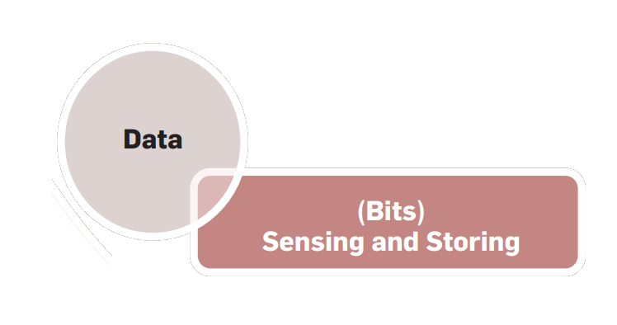
Some more history – evolution of challenges in IT
In the early days of computing, the challenge was to represent information in a machine-readable format that consisted of bits and bytes, called data

Slide 42
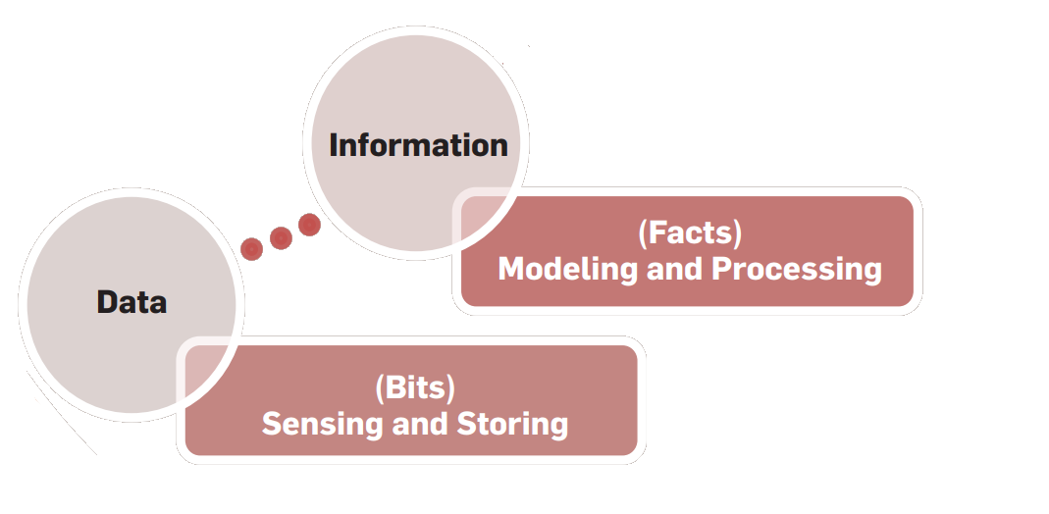
Some more history – evolution of challenges in IT
Over time, there was keen interest in complementing data with meaning, thus transforming it to information

Slide 43
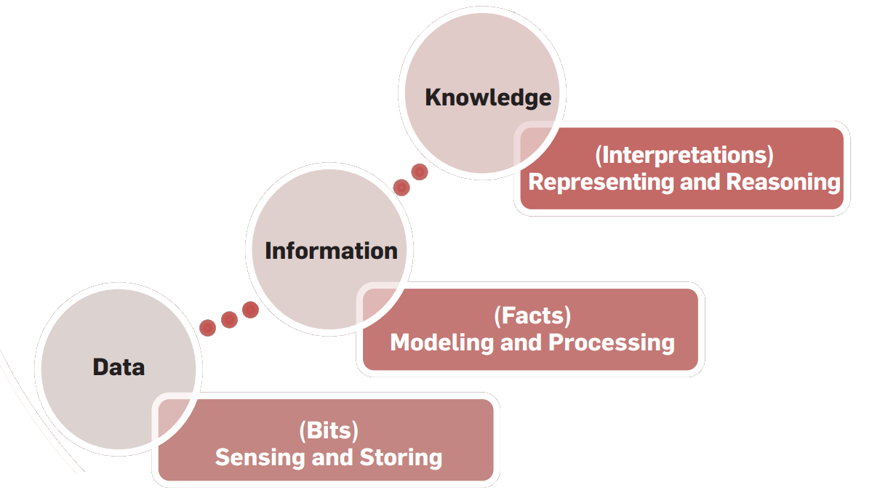
Some more history – evolution of challenges in IT
With further advances in computing came the idea of adding reasoning to information, thus giving rise to knowledge

Slide 44
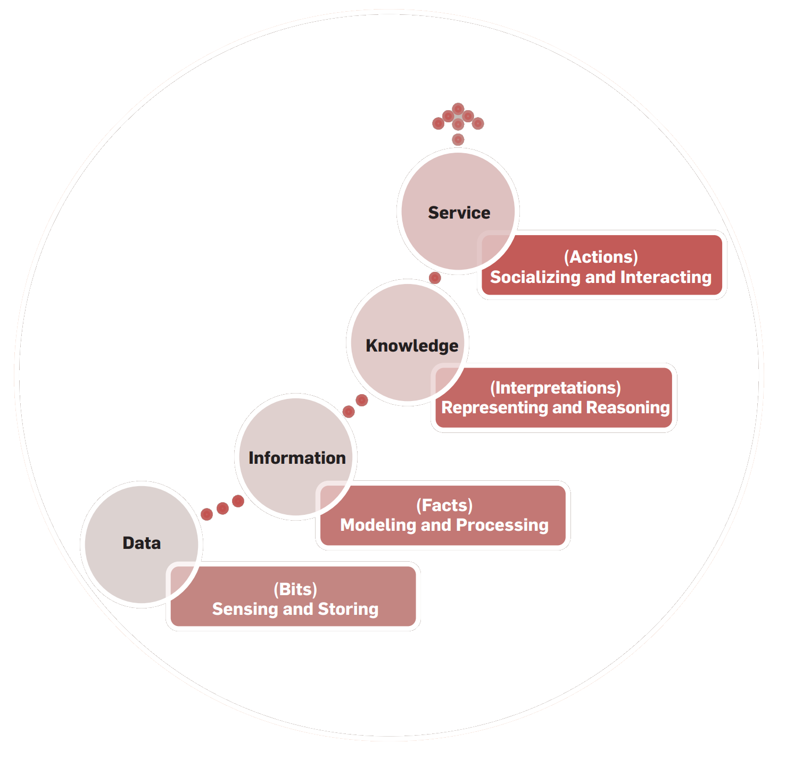
Some more history – evolution of challenges in IT
The need for higher levels of abstraction has recently led to the notion of adding action to knowledge, providing a way for knowledge to be useful, resulting in services

Slide 45
Trends in IT – towards service computing

Slide 46
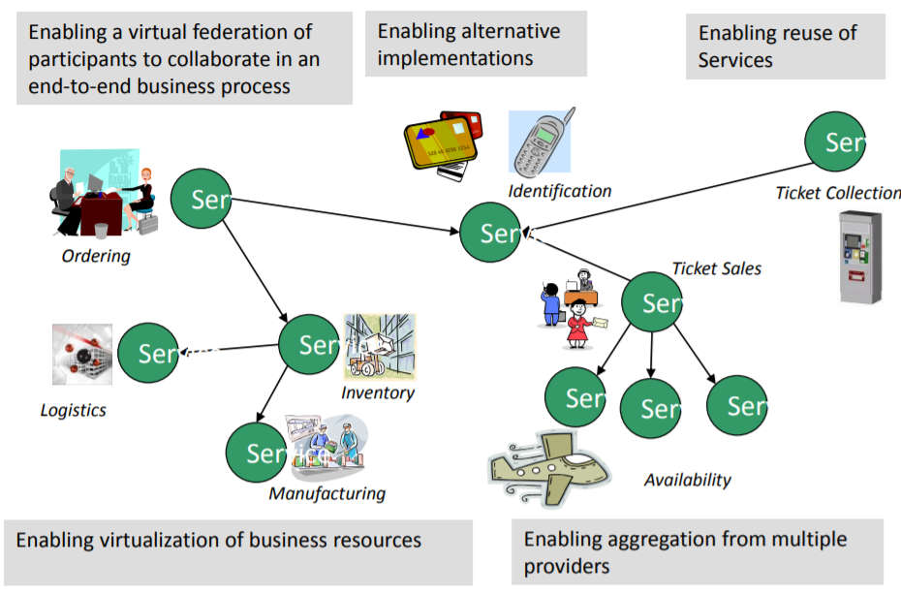
Motivation - ENABLE FLEXIBLE, FEDERATED BUSINESS PROCESSES
Enable flexible, federated business processes

Slide 47
Service orientation in an Enterprise
Enterprises (bank, aviation, restaurant )are made up of a set of Business Processes
manufacture products
buy and/or sell
receive money
issue invoices
pay staff
…
Most of these processes can be broken down into more fundamental discrete building blocks known as services.

Slide 48
The goal of Service Computing
Enable IT services and computing technology to perform business services more efficiently and effectively.
How to divide distributed systems to “services” which can be separately invoked through network requests and can provide independent functionalities
How to manage and evaluate existing services
How to reuse these services building more complex, composite services
How to assure quality of services

Slide 49
Activities in a service lifecycle
business componentization
services modelling
services creation
services realization
services annotation
services deployment
services discovery
services composition
services delivery
service-to-service collaboration
services monitoring
services optimization
services management

Slide 50
Importance of Service computing
Benefits for enterprises
Recent applications and underlying technologies

Slide 51
What are the expected benefits of service computing you can think of based on our discussion so far?

Slide 52
Business benefits – decreased cost
Decreased cost:
Add value to core investments by leveraging existing assets
New systems can be built faster for less money
Reducing integration expense
Built for flexibility
Long term value of interoperability

Slide 53
Business benefits – increased productivity
Increased employee productivity:
Built on existing skills
Consolidate duplicate functionality

Slide 54
Business benefits - partnership
Built for partnerships:
Standards based
Business relationships expressed via service interactions
Integration is driven by what is needed, not what is technically possible

Slide 55
Business benefits – agility
Agility - Built for change
Helps applications evolve over time and last
Abstract the backend and replace over time
Focusing on core-competencies
Incremental implementation approach is supported
Service Outsourcing – new business model!

Slide 56
Technical Benefits
Services Scale
Build scalable, evolvable systems
Scale down to mobile devices
Scale up to for large systems or across organizations
Manage complex systems
Does not require centralized services
Empowers users with high end communication
Platform independent use
Loose Coupling allows flexibility

Slide 57
Benefits for developers and users of service oriented systems

Slide 58
Service computing applications
Web applications
Mobile applications
Cloud systems
Big data applications
IoT Systems
Blockchain systems
Workflow systems
Other distributed systems

Slide 59
Underlying technologies
Web services
Service-oriented architecture (SOA)
Cloud computing
Business process modelling
….

Slide 60
How can this course benefit you?

Slide 61
Importance to you
Where/when the service computing knowledge/skills/thinking will be needed?

Slide 62
Summary
Service computing is based on a premise that problems can be modelled in terms of the services
A service is a self-contained unit of software functionality, or set of functionalities, designed to complete a specific task such as retrieving specified information or executing an operation
Services represent a type of relationships-based interactions (activities) between at least one service provider and one service consumer to achieve a certain business goal or solution objective.

